Slide 1
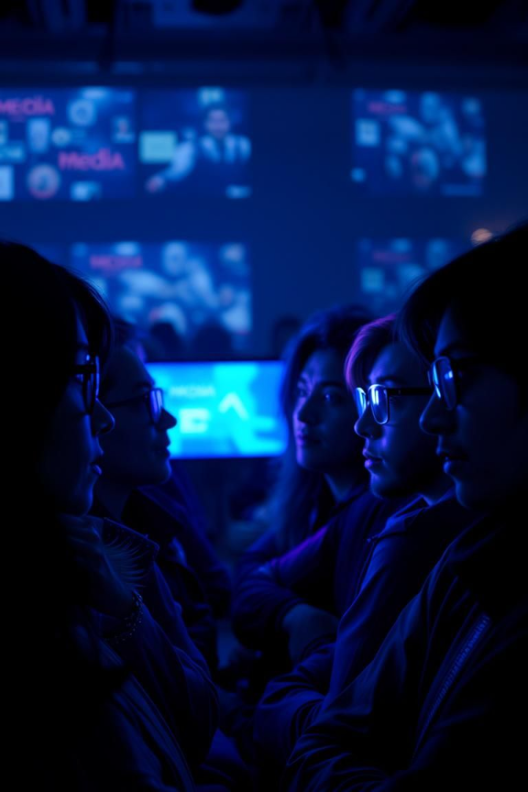

Media Influence: Shaping Public Opinion & The Role of Misinformation
A critical look at media’s power in shaping perceptions and beliefs.
by Himanshu

Slide 2
Understanding Media Influence
Defining Media Influence
Significance
Media's ability to shape public opinion and perceptions.
Critical role in politics, society, and decision-making.

Slide 3
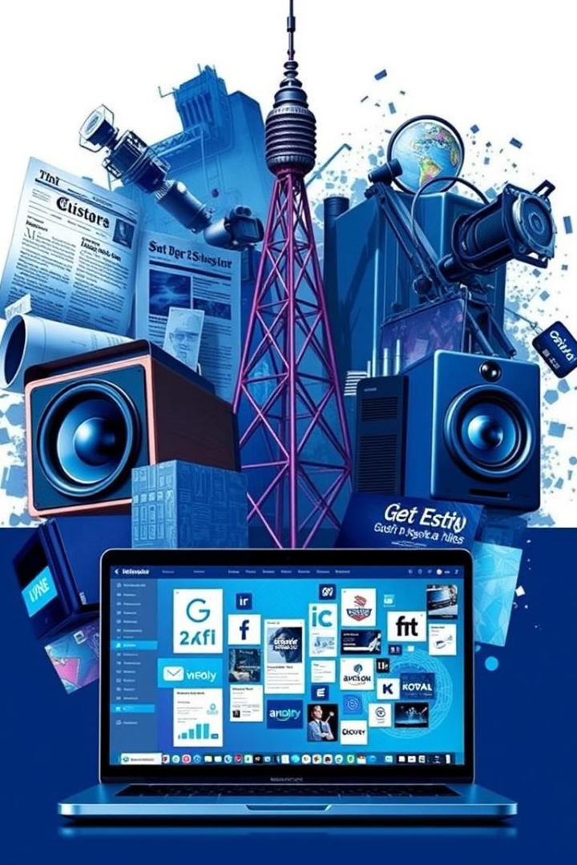
Types of Media
Traditional Media
Digital & Social Media
Newspapers, radio, and television broadcasting.
Websites, blogs, YouTube, Facebook, X, Instagram.
Alternative Media
Influencers and independent content creators.

Slide 4
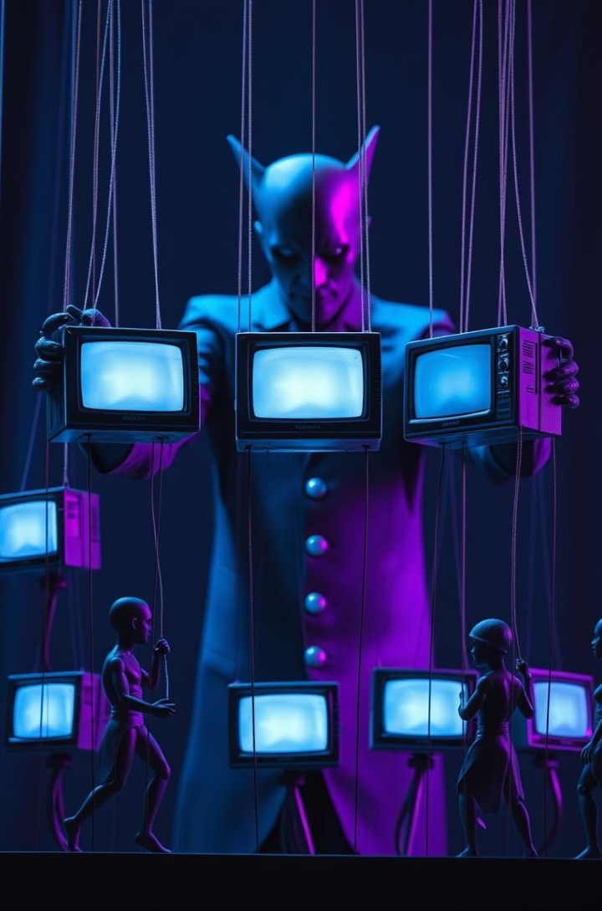




How Media Shapes Opinions
Agenda Setting
Framing
Priming
Media determines important issues.
Presentation influences interpretation.
Conditions audiences' thinking.
Repetition Effect
Exposure strengthens beliefs.

Slide 5
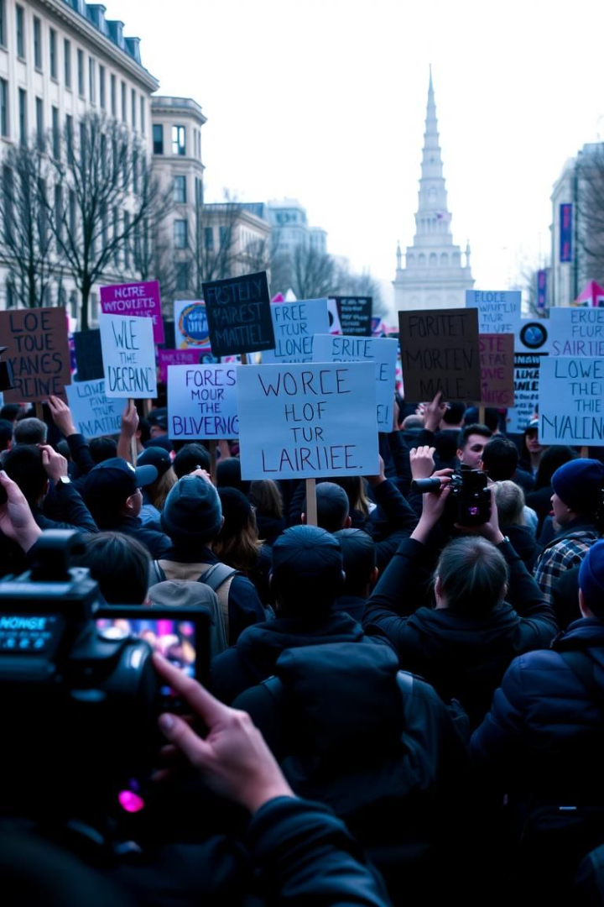



Media's Power in Politics & Society
Election Campaigns
Shaping political narratives.
Social Movements
Activism (e.g., #MeToo, Black Lives Matter).
Crisis Reporting
Pandemics and wars.

Slide 6
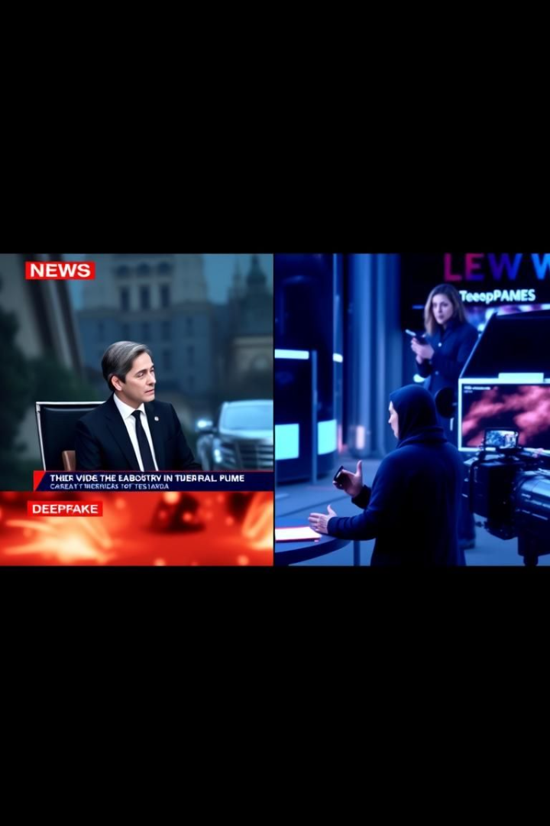




The Rise of Misinformation
Misinformation
False or inaccurate information.
Disinformation
Intentionally false information.
Malinformation
Based on reality, used to inflict harm
Tactics
Clickbait, deepfakes, misleading headlines.

Slide 7



Psychological Impact of Misinformation
Fear & Panic
2
Manipulation.
Confirmation Bias
1
Echo chambers.
Conspiracy Theories
3
Widespread.

Slide 8
Social Media's Role in Misinformation
Virality
1
Speed of fake news.
Amplification
2
Algorithmic boost.
Filter Bubbles
3
Limited perspectives.

Slide 9
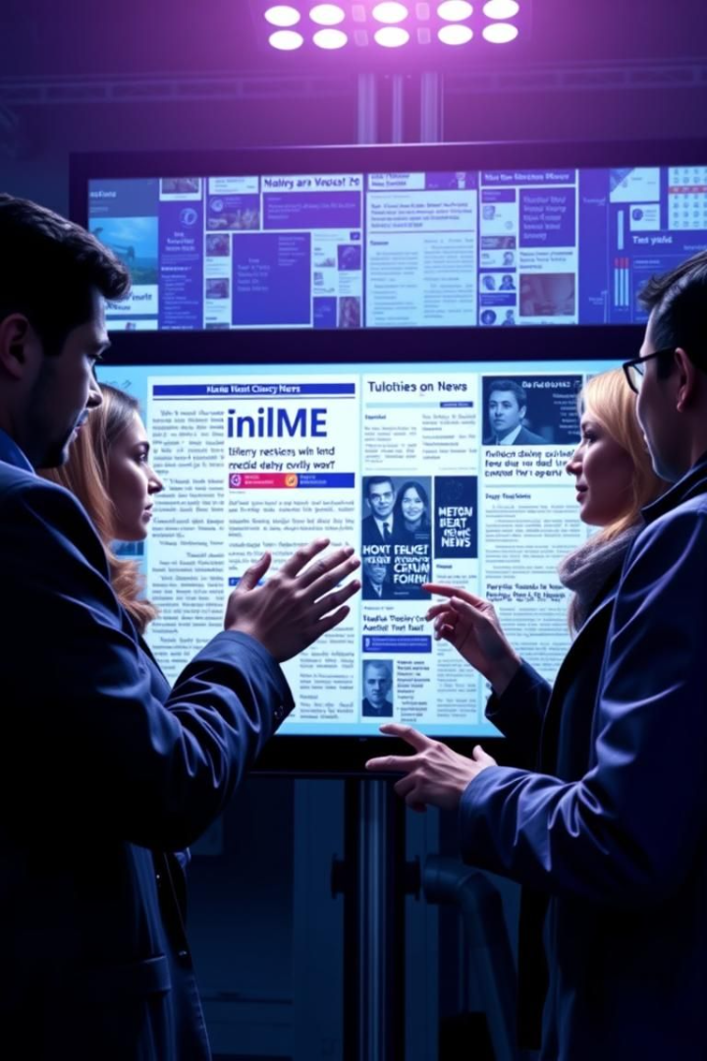
Fighting Misinformation: Solutions
1
2
Media Literacy
Fact-Checking
Critical thinking skills.
FactCheck.org.
3
AI Tools
Detecting fake news.

Slide 10

Conclusion & Key Takeaways
Media Power
Public Awareness
Can be manipulated.
Essential for critical analysis.
Responsibility
Individuals, platforms, policymakers.

